Slide 1
CEG5304 / EE6934 (PT2)
Lecture 12:
A Simple Introduction to:
Bayesian Neural Network &
Variational AutoEncoder (VAE)

Slide 2
Admin Issues for Week 12
Final Guest Lecture will be on Week 13 (16 April)
If have not attend last week’s briefing:
Make sure to watch the recording and download Examplify!

Slide 3
The Prior: Bayesian Inference & Bayesian Neural Network
Bayesian Inference
Source of Model Uncertainty and Ensembling
Bayesian Neural Netwosk

Slide 4
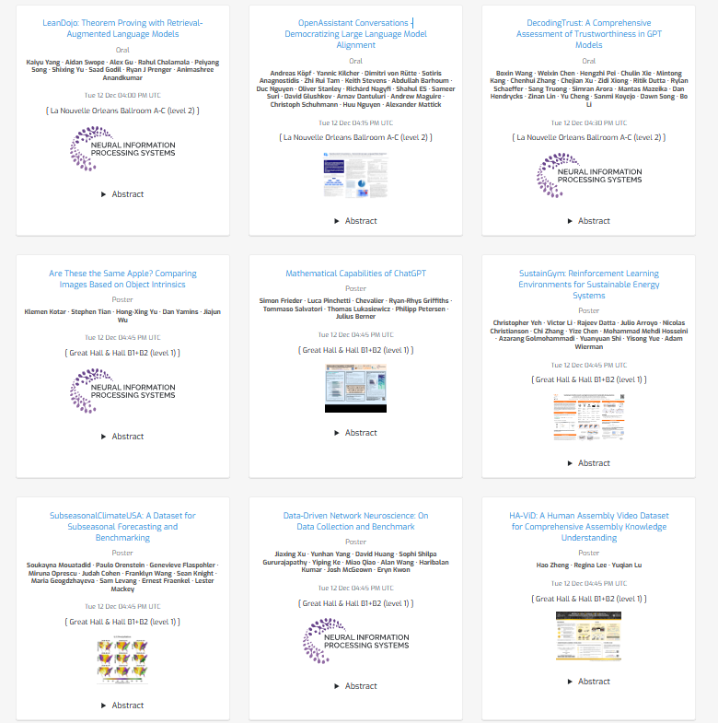
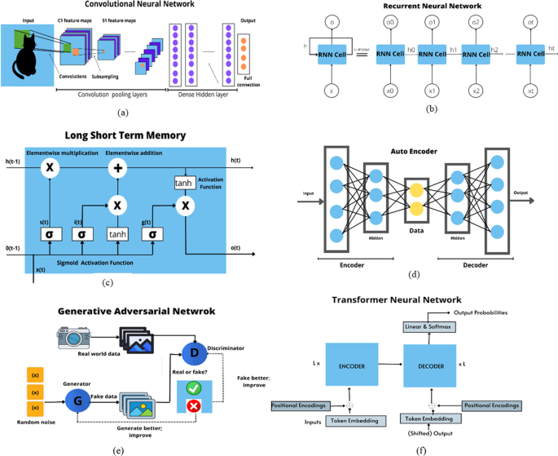
Quick Recap: Pillars of Deep Learning
The two pillars of Deep Learning: The Model and the Data

Slide 5
What We Have? What We Left Behind?
Good performance with ever increasing complexity of models:
Expressive, modular structure, efficient training.
Performances that are trained and evaluated on (a) certain dataset(s).
What about the generalization on other datasets?
Black-box model, judge the confidence over the model’s decision?
One (long forgotten) principle: the Occam’s Razor:
The problem-solving principle that recommends searching for explanations constructed with the smallest possible set of elements. It is also known as the principle of parsimony or the law of parsimony.
Notes:
Parsimony: 节俭，俭朴

Slide 6
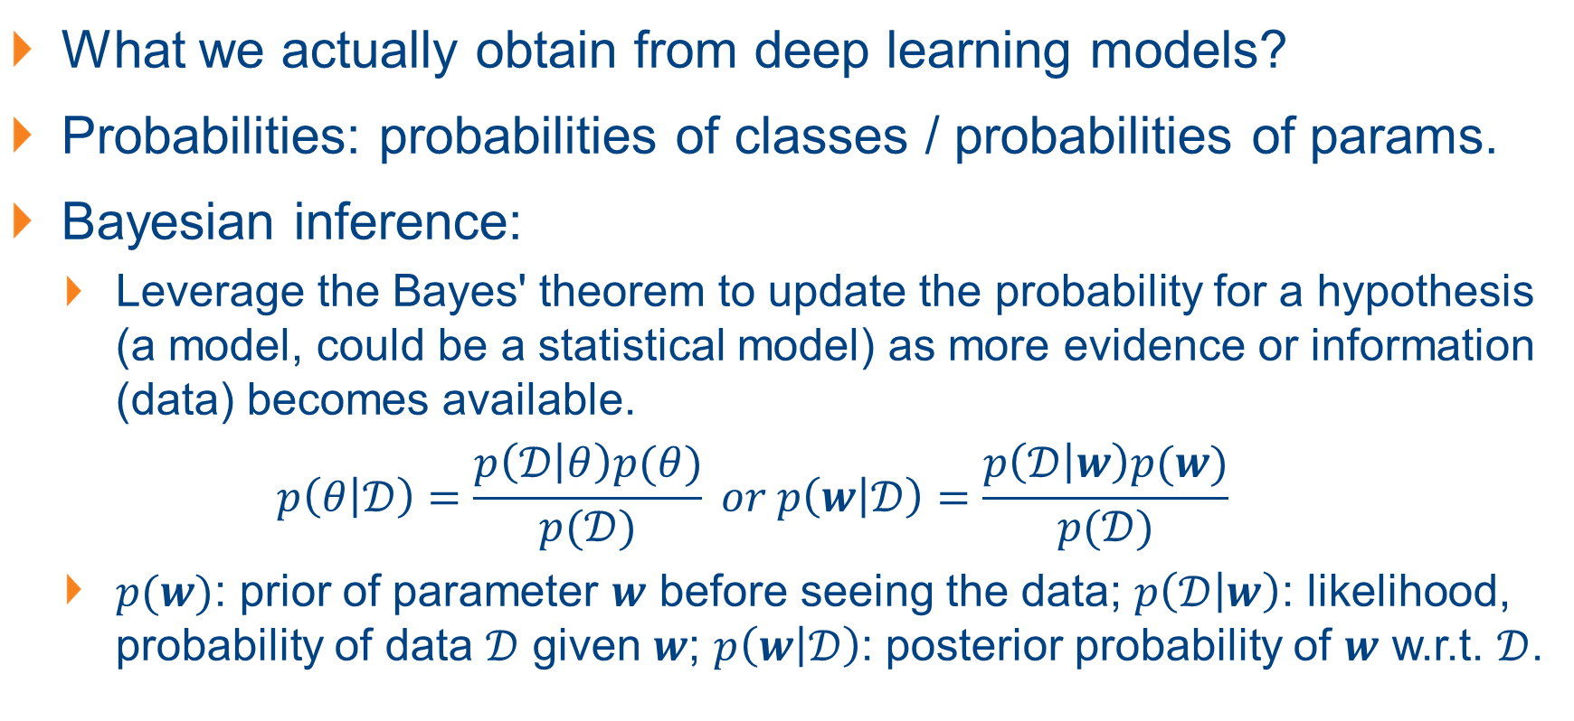
Bayesian Inference
What we actually obtain from deep learning models?
Probabilities: probabilities of classes / probabilities of params.
Bayesian inference:
Leverage the Bayes' theorem to update the probability for a hypothesis (a model, could be a statistical model) as more evidence or information (data) becomes available.
$$p\left(θ | 𝒟\right)=\frac{p\left(𝒟 | θ\right)p(θ)}{p(𝒟)} or p\left(w | 𝒟\right)=\frac{p\left(𝒟 | w\right)p(w)}{p(𝒟)}$$
$p(w)$: prior of parameter $w$ before seeing the data; $p\left(𝒟 | w\right)$: likelihood, probability of data $𝒟$ given $w$; $p\left(w | 𝒟\right)$: posterior probability of $w$ w.r.t. $𝒟$.

Slide 7
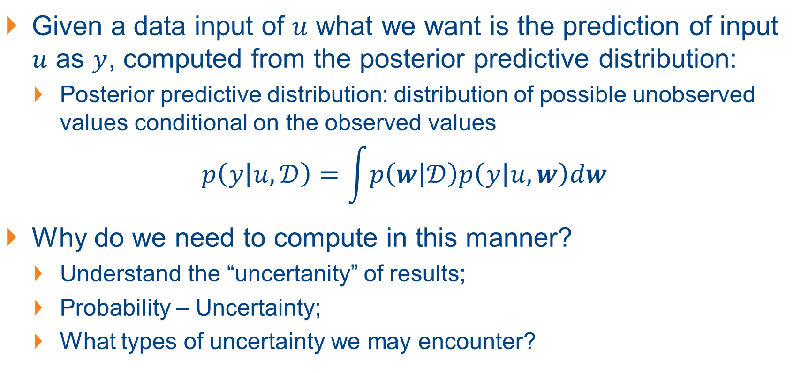
Bayesian Inference and Uncertainty
Given a data input of $u$ what we want is the prediction of input $u$ as $y$, computed from the posterior predictive distribution:
Posterior predictive distribution: distribution of possible unobserved values conditional on the observed values
$$p\left(y | u,𝒟\right)=\int{p\left(w | 𝒟\right)p\left(y | u,w\right)dw}$$
Why do we need to compute in this manner?
Understand the “uncertanity” of results;
Probability – Uncertainty;
What types of uncertainty we may encounter?

Slide 8
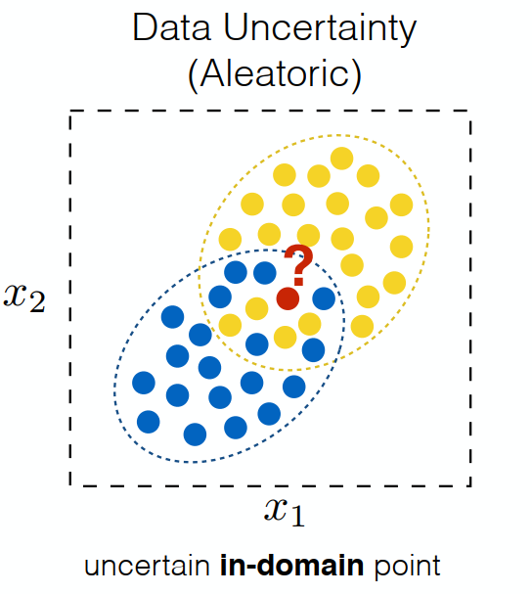
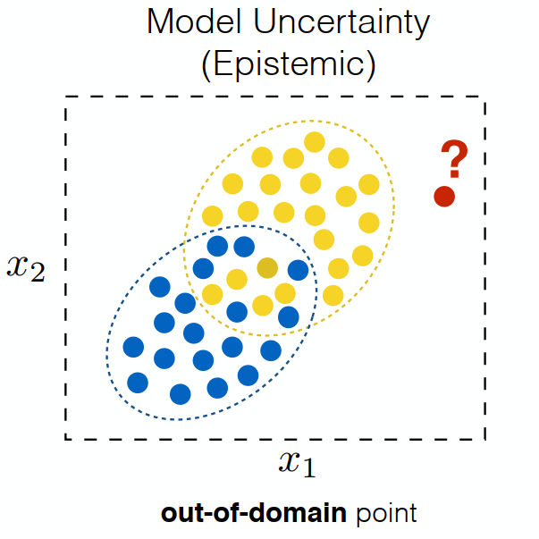
Uncertainty and Bayesian Inference
Aleatoric uncertainty: inherent uncertainty in the environment’s dynamics;
Output distribution for a classifier or a model (from the SoftMax).
Epistemic uncertainly: uncertainty about the model parameters:
Not considered with normal neural networks;
Different networks from different training processes.

Slide 9
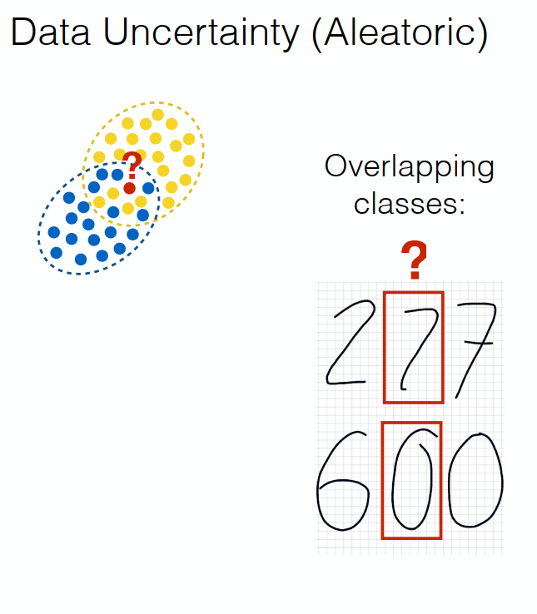
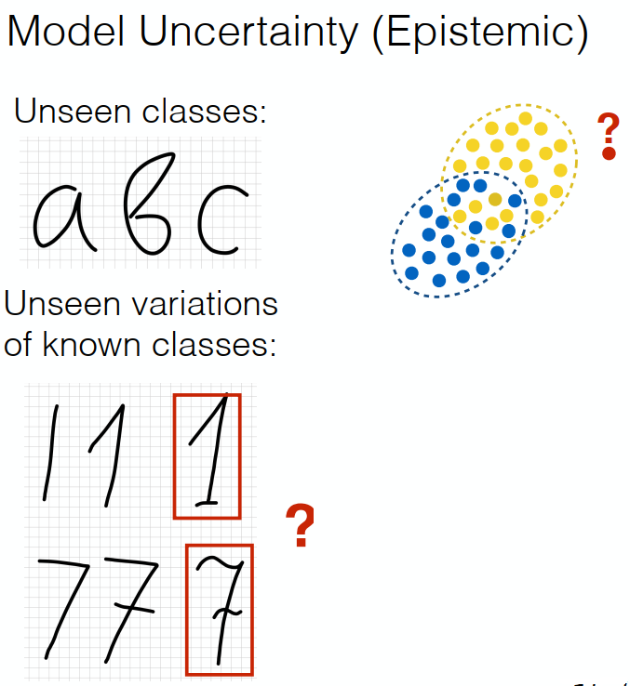
Examples of Uncertainty in Classification

Slide 10
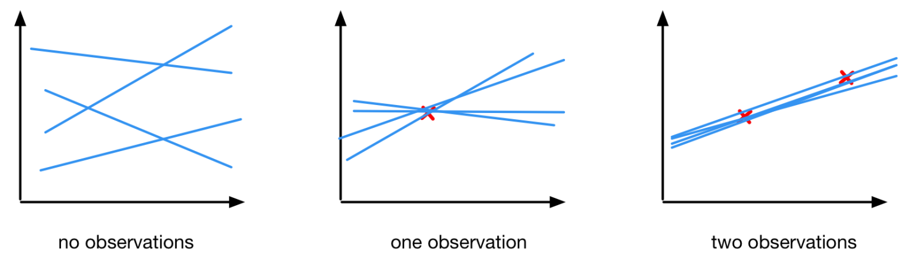
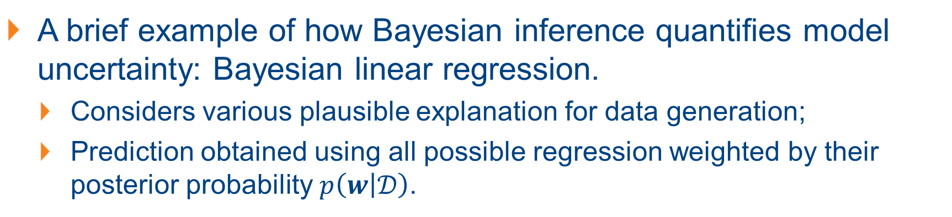
Quantifying Uncertainty with Bayesian Inference
A brief example of how Bayesian inference quantifies model uncertainty: Bayesian linear regression.
Considers various plausible explanation for data generation;
Prediction obtained using all possible regression weighted by their posterior probability $p\left(w | 𝒟\right)$.

Slide 11
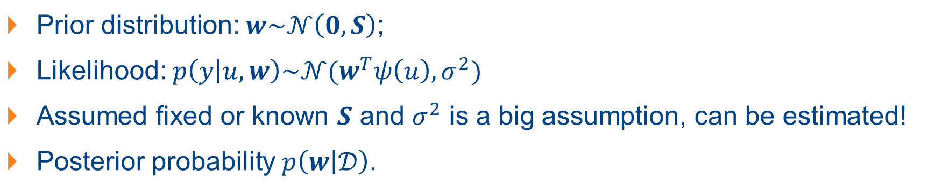
Example: Bayesian Linear Regression
Prior distribution: $w\sim 𝒩\left(0,S\right)$;
Likelihood: $p\left(y | u,w\right)\sim 𝒩(w^{T}ψ\left(u\right), σ^{2})$
Assumed fixed or known $S$ and $σ^{2}$ is a big assumption, can be estimated!
Posterior probability $p\left(w | 𝒟\right)$.

Slide 12
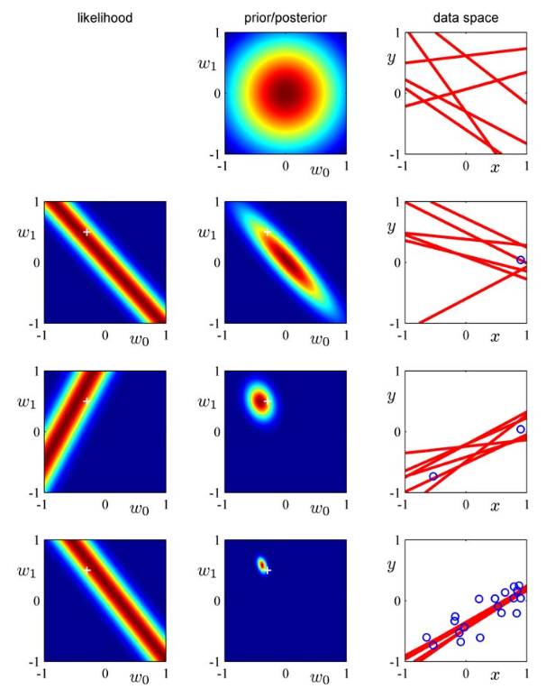
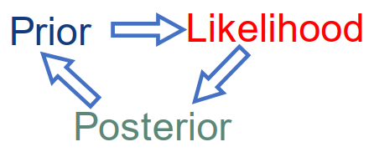
Example: Bayesian Linear Regression
The connection between prior, likelihood, posterior:
Line 1: prior distribution;
Lines 2 – 4: Model dist. is adjusted with to observed data

Slide 13
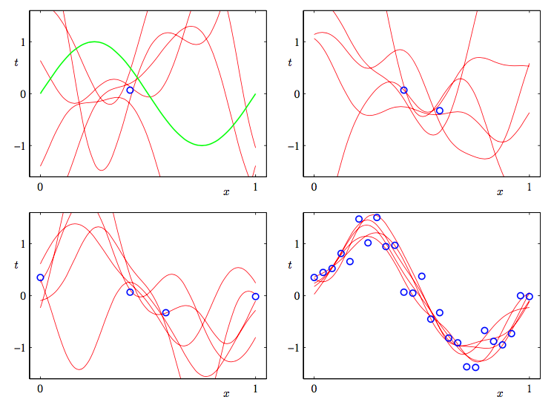
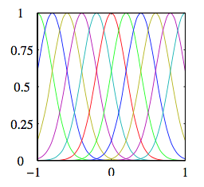
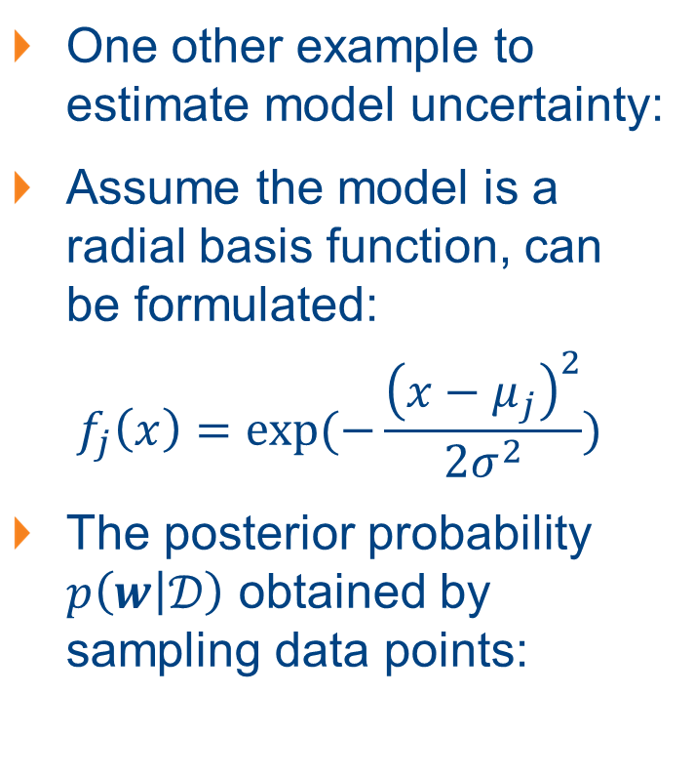
Another Example of Bayesian Regression
One other example to estimate model uncertainty:
Assume the model is a radial basis function, can be formulated:
$$f_{j}\left(x\right)=exp⁡(−\frac{{\left(x−μ_{j}\right)}^{2}}{2σ^{2}})$$
The posterior probability $p\left(w | 𝒟\right)$ obtained by sampling data points:

Slide 14
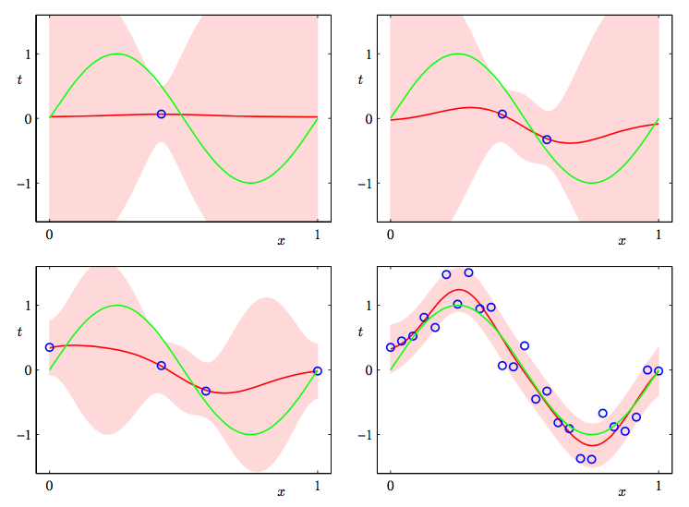
Visualizing Confidence Interval vs. Data Observation
Visualize confidence intervals based on the posterior predictive mean and variance at each point.

Slide 15
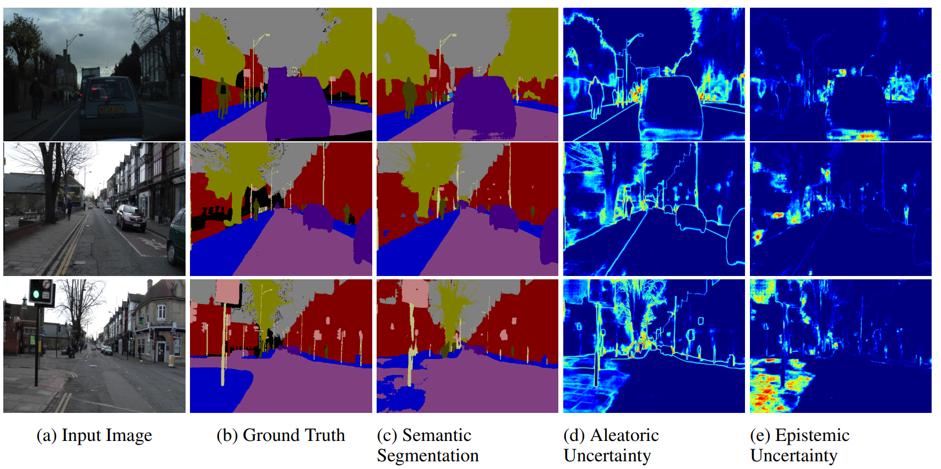
Data Uncertainty vs. Model Uncertainty
Notes:
Illustrating the difference between aleatoric and epistemic uncertainty for semantic segmentation on the CamVid dataset. Aleatoric uncertainty captures noise inherent in the observations. In (d) our model exhibits increased aleatoric uncertainty on object boundaries and for objects far from the camera. Epistemic uncertainty accounts for our ignorance about which model generated our collected data. This is a notably different measure of uncertainty and in (e) our model exhibits increased epistemic uncertainty for semantically and visually challenging pixels. The bottom row shows a failure case of the segmentation model when the model fails to segment the footpath due to increased epistemic uncertainty, but not aleatoric uncertainty.

Slide 16
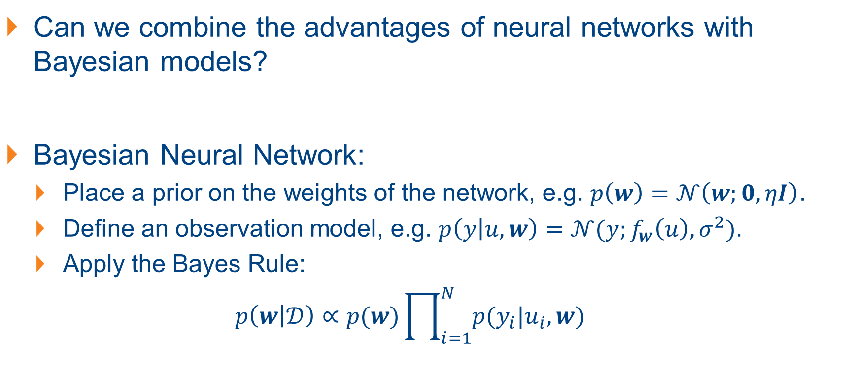
Bayesian Neural Network?
Can we combine the advantages of neural networks with Bayesian models?
Bayesian Neural Network:
Place a prior on the weights of the network, e.g. $p\left(w\right)=𝒩\left(w;0, ηI\right)$.
Define an observation model, e.g. $p\left(y | u, w\right)=𝒩(y;f_{w}\left(u\right), σ^{2})$.
Apply the Bayes Rule:
$$p\left(w | 𝒟\right)∝p(w)\prod_{i=1}^{N}{p(y_{i}|u_{i},w)}$$
Notes:
$p(w)$: prior of parameter $w$ before seeing the data; $p\left(𝒟 | w\right)$: likelihood, probability of data $𝒟$ given $w$; $p\left(w | 𝒟\right)$: posterior probability of $w$ w.r.t. $𝒟$

Slide 17
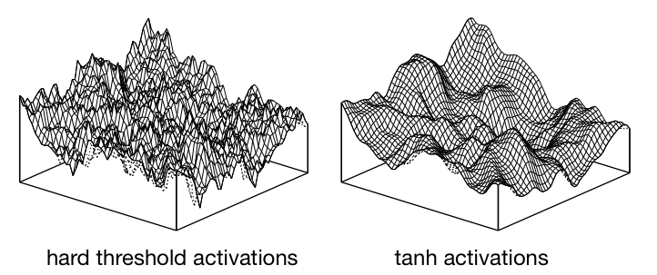
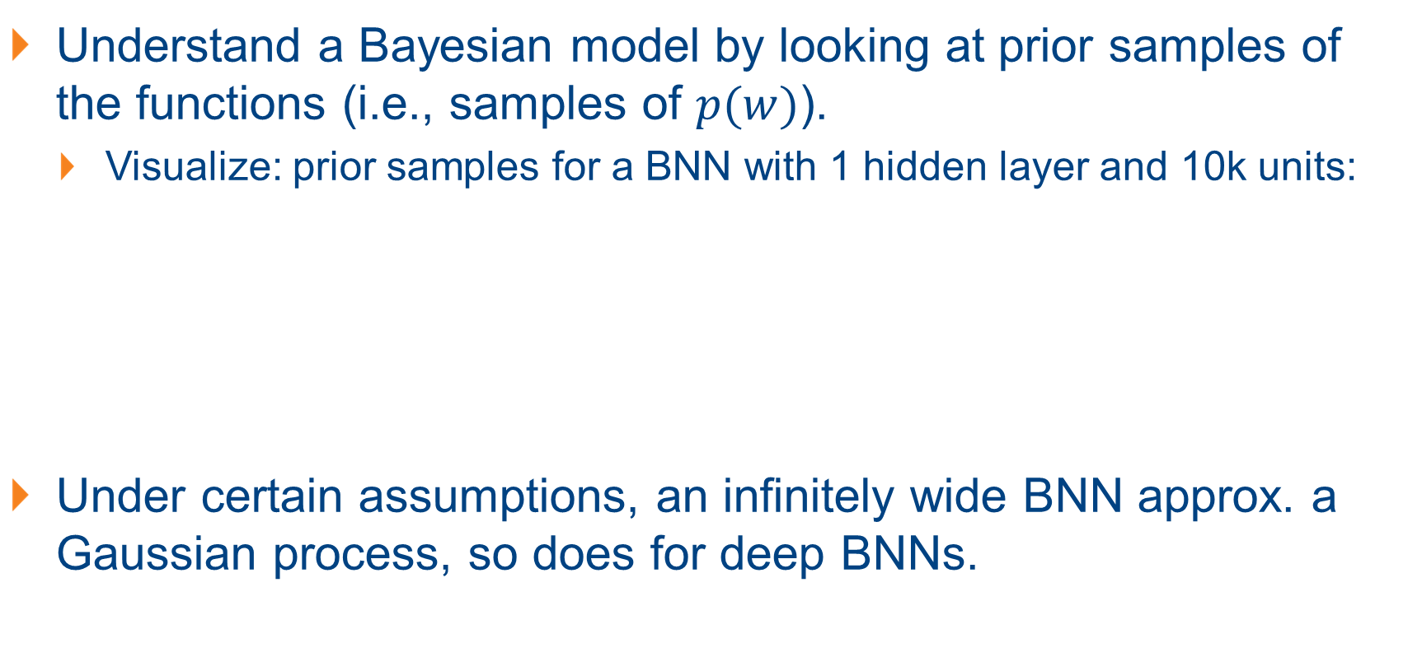
Bayesian Model: Samples from the Prior
Understand a Bayesian model by looking at prior samples of the functions (i.e., samples of $p(w)$).
Visualize: prior samples for a BNN with 1 hidden layer and 10k units:
Under certain assumptions, an infinitely wide BNN approx. a Gaussian process, so does for deep BNNs.
Notes:
$p(w)$: prior of parameter $w$ before seeing the data; $p\left(𝒟 | w\right)$: likelihood, probability of data $𝒟$ given $w$; $p\left(w | 𝒟\right)$: posterior probability of $w$ w.r.t. $𝒟$

Slide 18
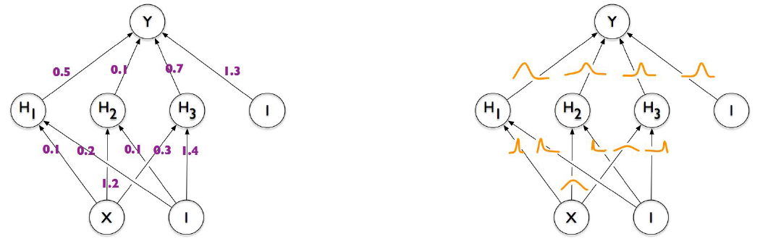
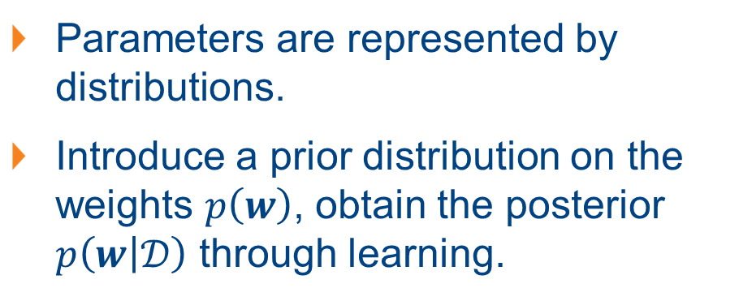
BNN vs NN (in General with DNN)
Regularization arises naturally!
(Think of dropout)
Parameters represented by single, fixed values after training.
Conventional approaches to train NNs can be interpreted as approx. to the Bayesian method
Parameters are represented by distributions.
Introduce a prior distribution on the weights $p\left(w\right)$, obtain the posterior $p\left(w | 𝒟\right)$ through learning.

Slide 19
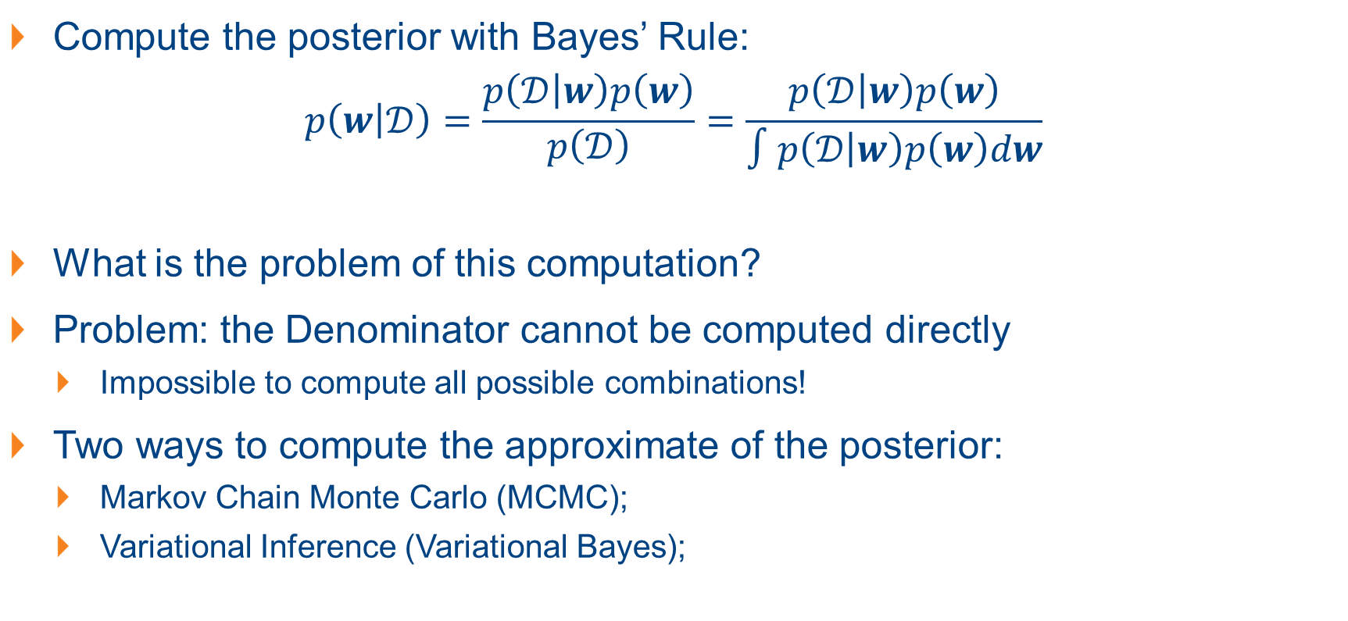
BNN: Maximizing the Posterior
Compute the posterior with Bayes’ Rule:
$$p\left(w | 𝒟\right)=\frac{p\left(𝒟 | w\right)p\left(w\right)}{p\left(𝒟\right)}=\frac{p\left(𝒟 | w\right)p\left(w\right)}{∫p\left(𝒟 | w\right)p\left(w\right)dw}$$
What is the problem of this computation?
Problem: the Denominator cannot be computed directly
Impossible to compute all possible combinations!
Two ways to compute the approximate of the posterior:
Markov Chain Monte Carlo (MCMC);
Variational Inference (Variational Bayes);
Notes:
$p(w)$: prior of parameter $w$ before seeing the data; $p\left(𝒟 | w\right)$: likelihood, probability of data $𝒟$ given $w$; $p\left(w | 𝒟\right)$: posterior probability of $w$ w.r.t. $𝒟$

Slide 20
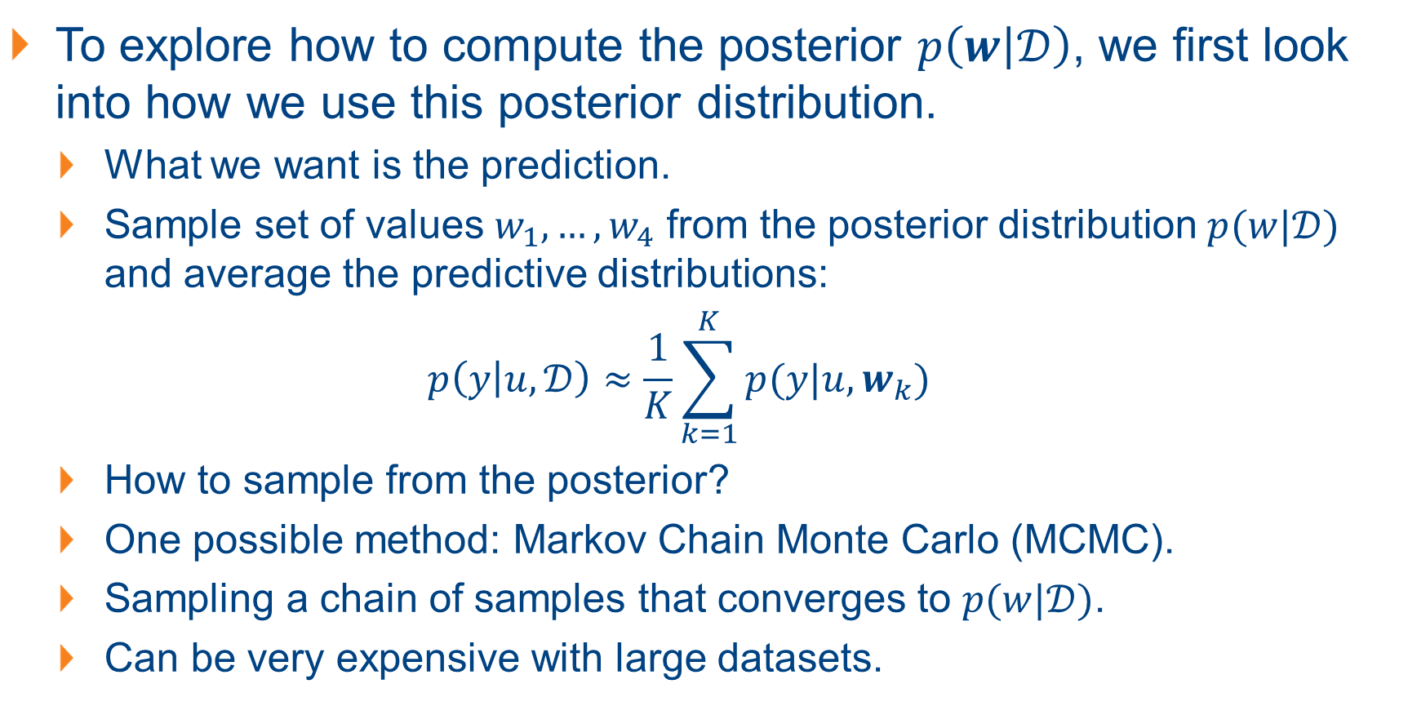
Posterior Inference with Markov Chain Monte Carlo
To explore how to compute the posterior $p\left(w | 𝒟\right)$, we first look into how we use this posterior distribution.
What we want is the prediction.
Sample set of values $w_{1}, …, w_{4}$ from the posterior distribution $p(w|𝒟)$ and average the predictive distributions:
$$p\left(y | u, 𝒟\right)≈\frac{1}{K}\sum_{k=1}^{K}{p(y|u, w_{k})}$$
How to sample from the posterior?
One possible method: Markov Chain Monte Carlo (MCMC).
Sampling a chain of samples that converges to $p(w|𝒟)$.
Can be very expensive with large datasets.

Slide 21
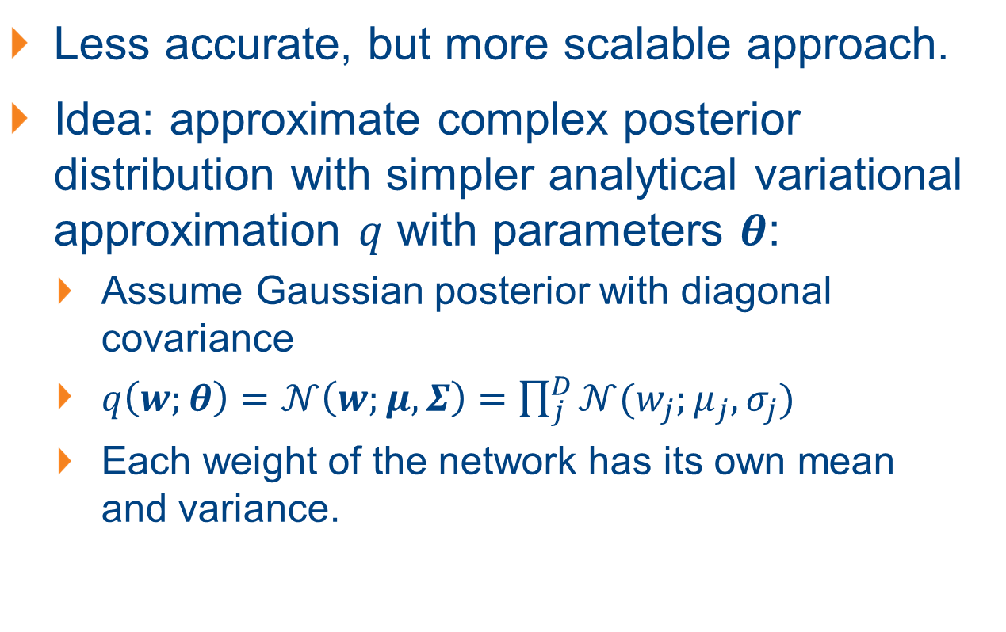
Posterior Inference: Variational Bayes
Less accurate, but more scalable approach.
Idea: approximate complex posterior distribution with simpler analytical variational approximation $q$ with parameters $θ$:
Assume Gaussian posterior with diagonal covariance
$q\left(w;θ\right)=𝒩\left(w;μ,Σ\right)=\prod_{j}^{D}{𝒩(w_{j};μ_{j},σ_{j})}$
Each weight of the network has its own mean and variance.

Slide 22
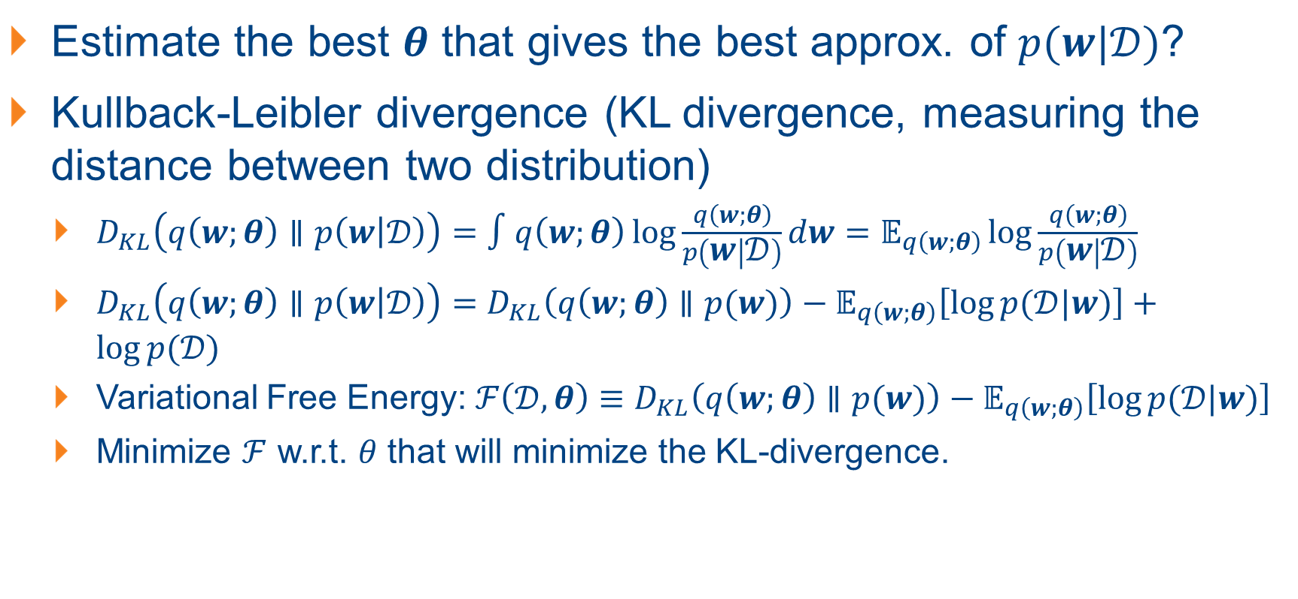
Posterior Inference: Variational Bayes
Estimate the best $θ$ that gives the best approx. of $p(w|𝒟)$?
Kullback-Leibler divergence (KL divergence, measuring the distance between two distribution)
$D_{KL}\left(q\left(w;θ\right)∥p\left(w | 𝒟\right)\right)=∫q\left(w;θ\right)\log{\frac{q\left(w;θ\right)}{p\left(w | 𝒟\right)}}dw=𝔼_{q\left(w;θ\right)}\log{\frac{q\left(w;θ\right)}{p\left(w | 𝒟\right)}}$
$D_{KL}\left(q\left(w;θ\right)∥p\left(w | 𝒟\right)\right)=D_{KL}\left(q\left(w;θ\right)∥p(w)\right)−𝔼_{q\left(w;θ\right)}\left[\log{p(𝒟|w)}\right]+\log{p(𝒟)}$
Variational Free Energy: $ℱ\left(𝒟,θ\right)≡D_{KL}\left(q\left(w;θ\right)∥p(w)\right)−𝔼_{q\left(w;θ\right)}\left[\log{p(𝒟|w)}\right]$
Minimize $ℱ$ w.r.t. $θ$ that will minimize the KL-divergence.

Slide 23
Uses of BNNs (Some)
Bayesian optimization: Snoek et al., 2015. Scalable Bayesian optimization using deep neural networks.
Curriculum learning: Graves et al., 2017. Automated curriculum learning for neural networks
Intrinsic motivation in reinforcement learning: Houthooft et al., 2016. Variational information maximizing exploration
Network compression: Louizos et al., 2017. Bayesian compression for deep learning

Slide 24
An Example of BNN: Variational AutoEncoders (VAEs): Generative Models and Representation Learning
Generative Modeling and Representation Learning
Variational AutoEncoders (VAEs)
Notes:
A case where a density model might be preferable over an energy model is a medical imaging system that needs to communicate to doctors the likelihood that a patient has cancer.

Slide 25
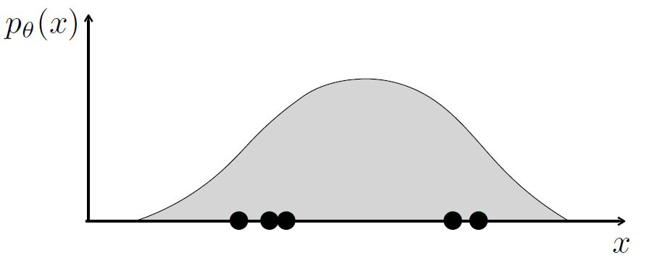
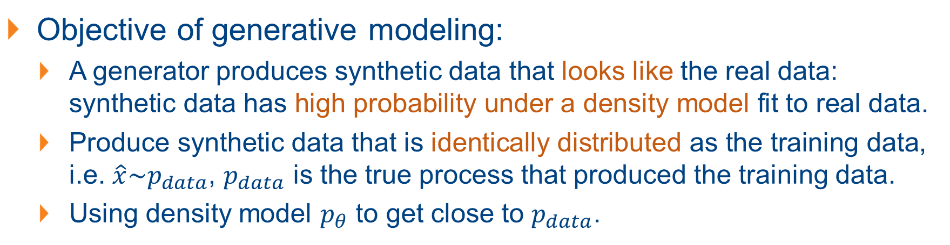
Learning Generative Models via Density Models
Objective of generative modeling:
A generator produces synthetic data that looks like the real data: synthetic data has high probability under a density model fit to real data.
Produce synthetic data that is identically distributed as the training data, i.e. $\hat{x}\sim p_{data}$, $p_{data}$ is the true process that produced the training data.
Using density model $p_{θ}$ to get close to $p_{data}$.

Slide 26
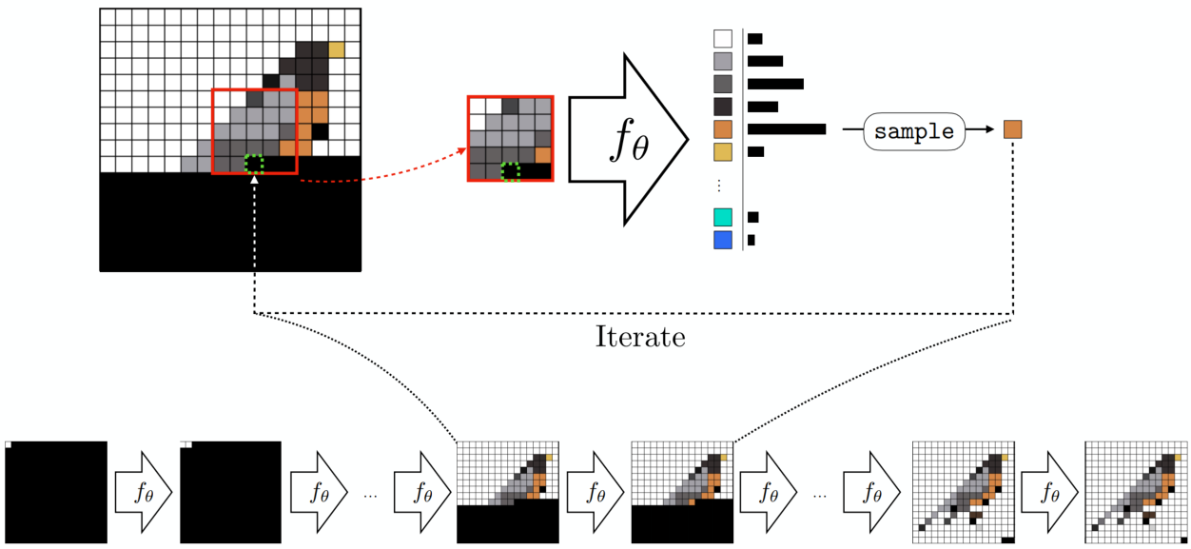
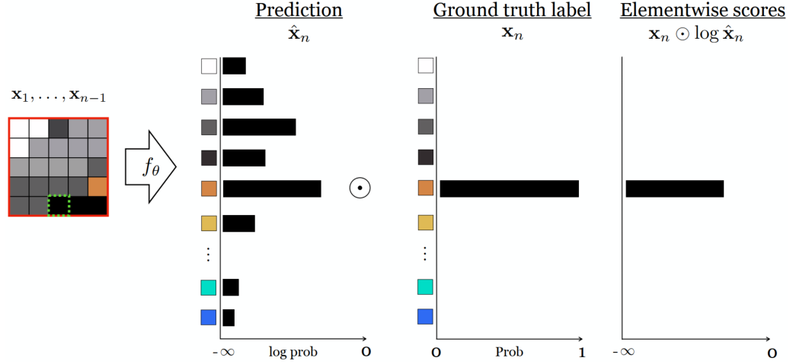
Autoregressive Models: Image Generation
Synthesize an image pixel-by-pixel
Predict each next pixel from the partial image already completed – from the context of the partial image.

Slide 27
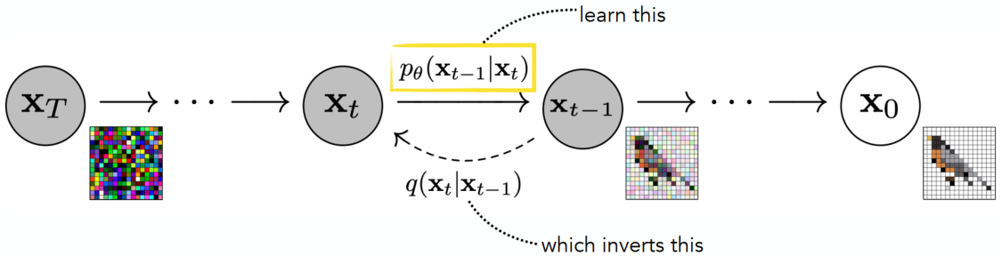
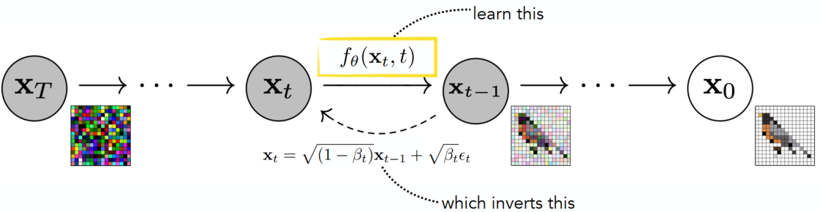
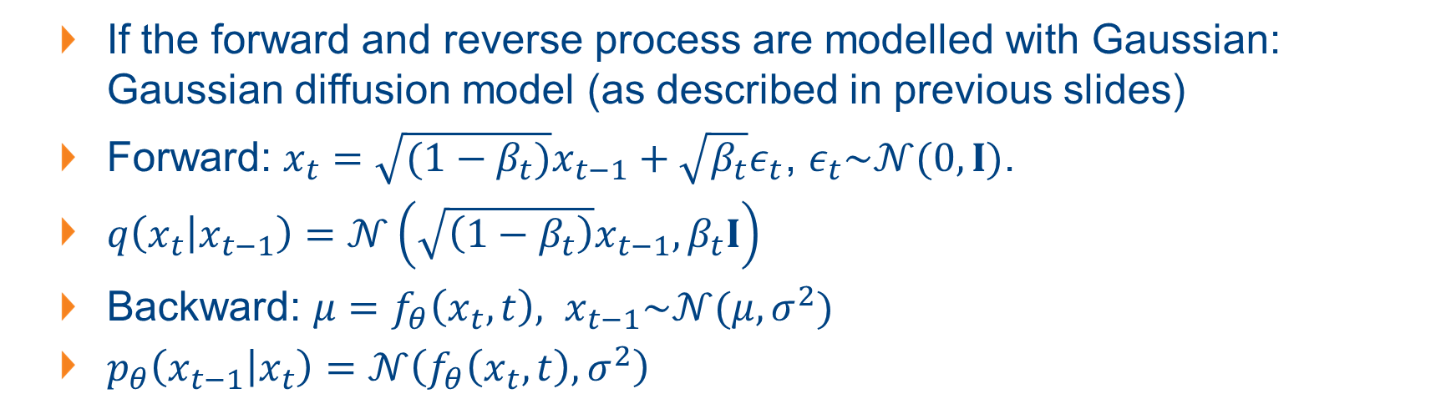
The Gaussian Diffusion Model
If the forward and reverse process are modelled with Gaussian: Gaussian diffusion model (as described in previous slides)
Forward: $x_{t}=\sqrt{(1−β_{t})}x_{t−1}+\sqrt{β_{t}}ε_{t}$, $ε_{t}\sim 𝒩(0, I)$.
$q\left(x_{t} | x_{t−1}\right)=𝒩\left(\sqrt{\left(1−β_{t}\right)}x_{t−1},β_{t}I\right)$
Backward: $μ=f_{θ}\left(x_{t}, t\right), x_{t−1}\sim 𝒩(μ,σ^{2})$
$p_{θ}\left(x_{t−1} | x_{t}\right)=𝒩\left(f_{θ}\left(x_{t}, t\right),σ^{2}\right)$
Notes:
The variances, beta, and signma are modeling choices.

Slide 28
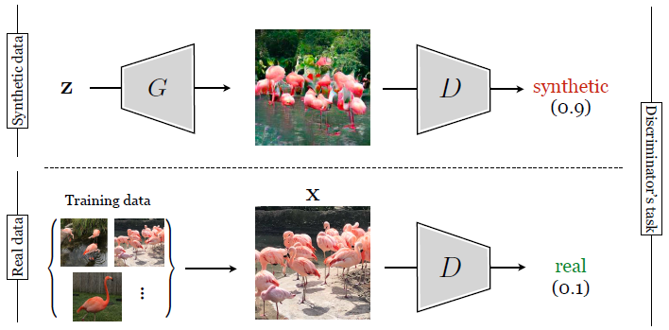
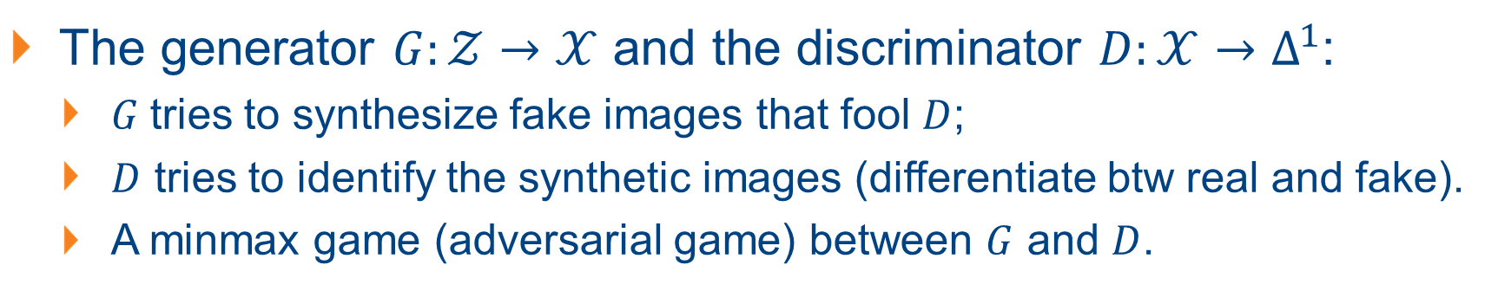
The Generative Adversarial Network (GAN)
The generator $G:𝒵→𝒳$ and the discriminator $D:𝒳→Δ^{1}$:
$G$tries to synthesize fake images that fool $D$;
$D$ tries to identify the synthetic images (differentiate btw real and fake).
A minmax game (adversarial game) between $G$ and $D$.

Slide 29
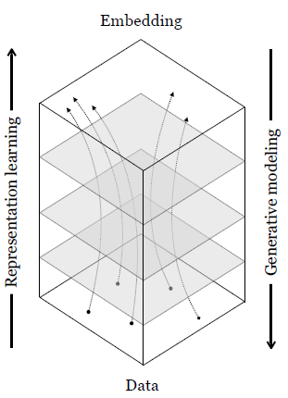
Generative Modelling v.s. Representation Learning
Representation learning: mapping data to abstract representation (for data analysis)
Generative modelling: mapping abstract representations to data (for data synthesis)

Slide 30
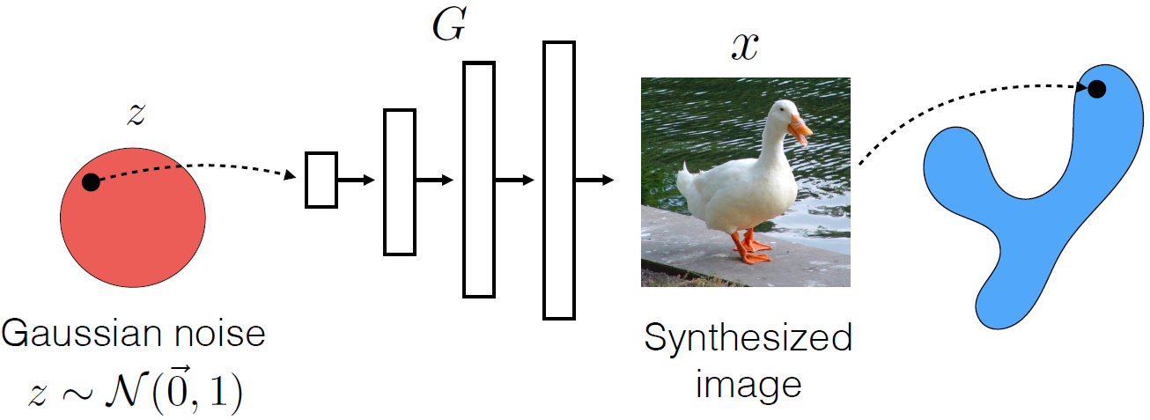
How does Generative Modelling Effect Distribution?
We can view generative models as distribution transformers (not the Transformers):
Transforming from a latent space to the data distribution space.

Slide 31
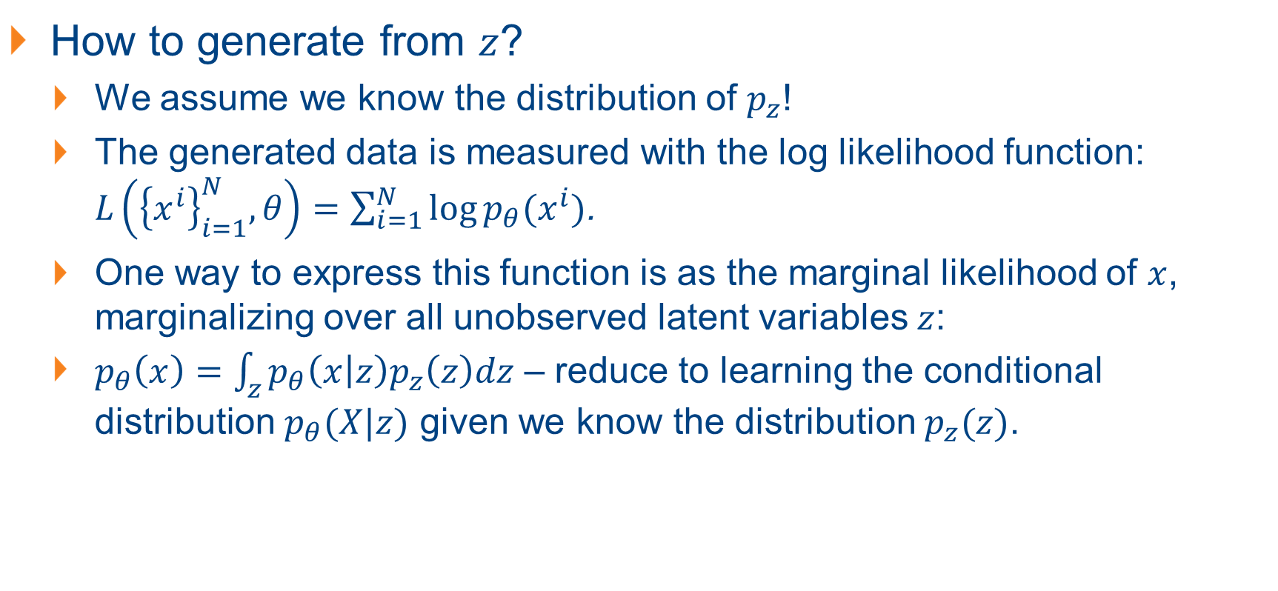
Properties of Generative Modelling
How to generate from $z$?
We assume we know the distribution of $p_{z}$!
The generated data is measured with the log likelihood function: $L\left({\left\{x^{i}\right\}}_{i=1}^{N}, θ\right)=\sum_{i=1}^{N}{\log{p_{θ}(x^{i})}}$.
One way to express this function is as the marginal likelihood of $x$, marginalizing over all unobserved latent variables $z$:
$p_{θ}\left(x\right)=\int_{z}{p_{θ}\left(x | z\right)p_{z}\left(z\right)dz}$ – reduce to learning the conditional distribution $p_{θ}(X|z)$ given we know the distribution $p_{z}(z)$.
To compute

Slide 32
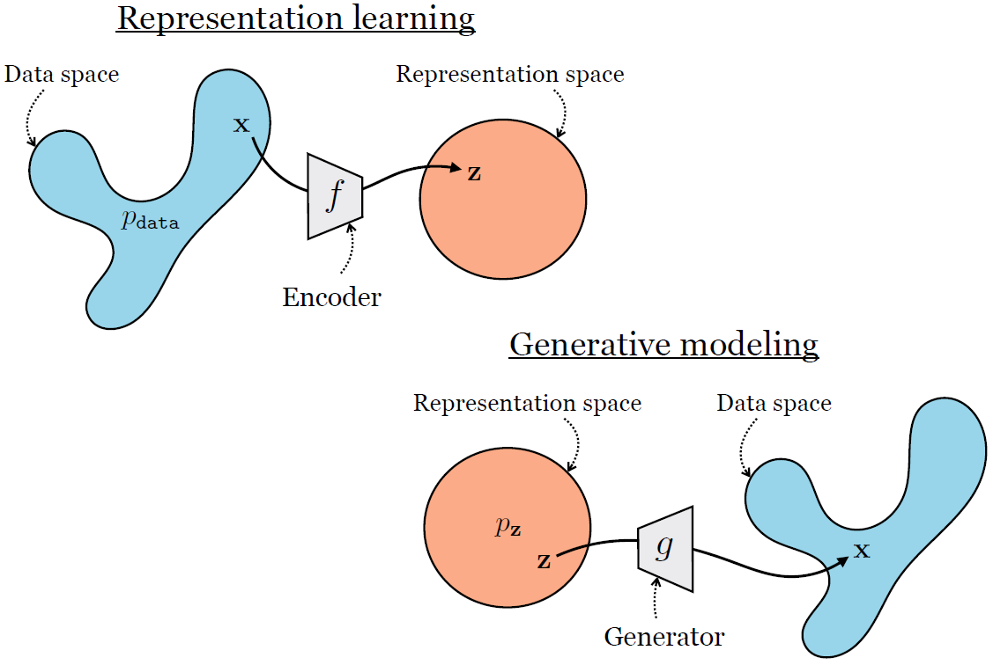
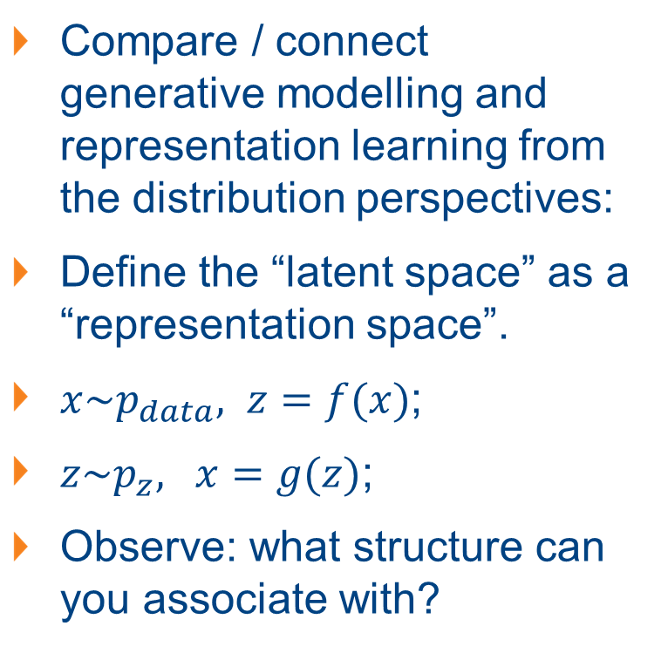
Generative Modelling v.s. Representation Learning
Compare / connect generative modelling and representation learning from the distribution perspectives:
Define the “latent space” as a “representation space”.
$x\sim p_{data}, z=f(x)$;
$z\sim p_{z}, x=g(z)$;
Observe: what structure can you associate with?

Slide 33
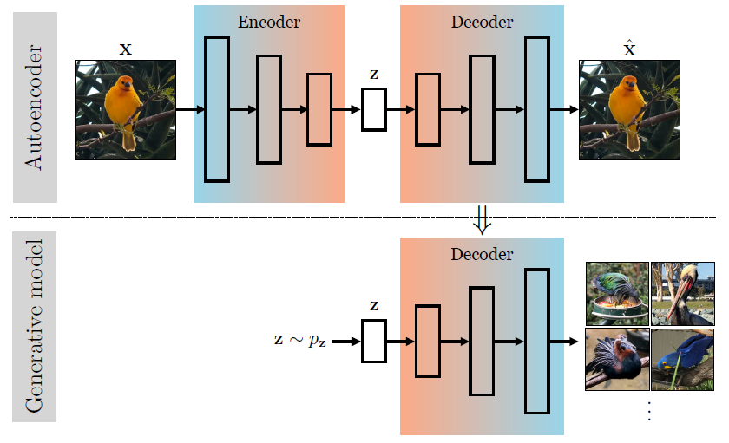
Generative Modelling with Autoencoder (AE)
Autoencoder: models that learn an embedding that can be decoded to reconstruct the input data.
Connection: decoder of an autoencoder similar to a generator.
Notes:
Given a $z$, we can synthesize an image by passing it through the decoder of the autoencoder.

Slide 34
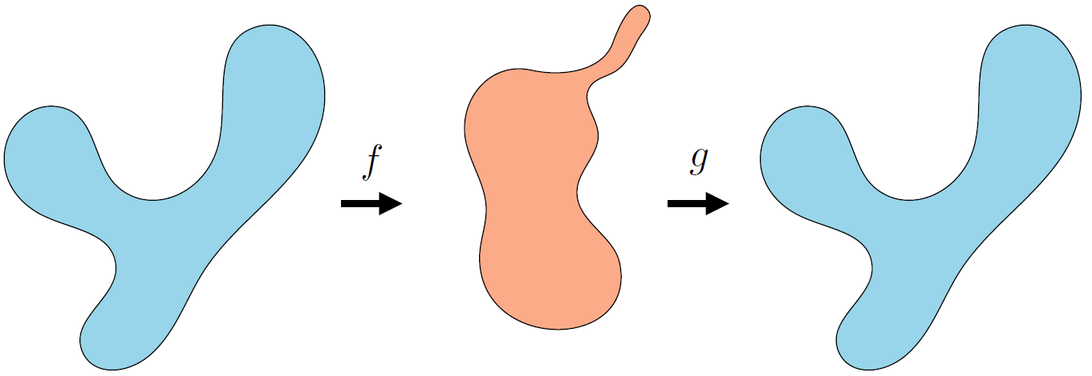
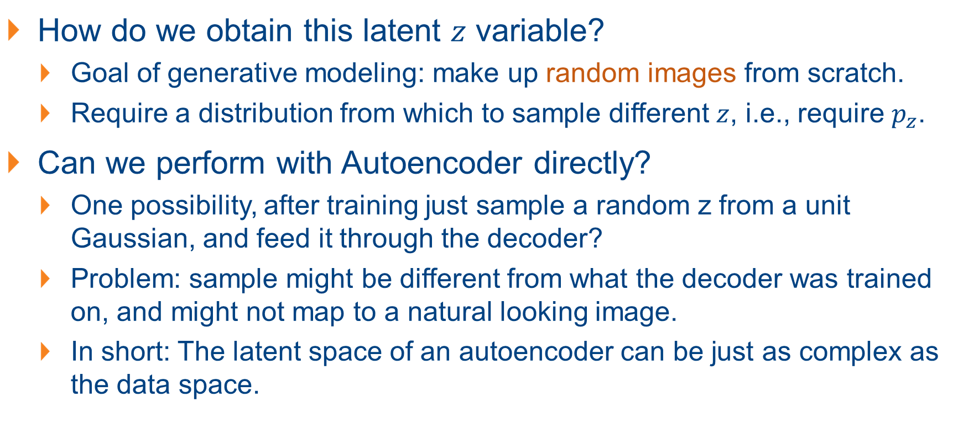
Adapting Autoencoder (AE) for Generative Modelling
How do we obtain this latent $z$ variable?
Goal of generative modeling: make up random images from scratch.
Require a distribution from which to sample different $z$, i.e., require $p_{z}$.
Can we perform with Autoencoder directly?
One possibility, after training just sample a random z from a unit Gaussian, and feed it through the decoder?
Problem: sample might be different from what the decoder was trained on, and might not map to a natural looking image.
In short: The latent space of an autoencoder can be just as complex as the data space.
Notes:
For example, maybe the encoder has learned to map all images to embeddings far from the origin; then a unit Gaussian z would be far out of distribution and the decoder’s behavior could be arbitrary for this out-of-distribution input.

Slide 35
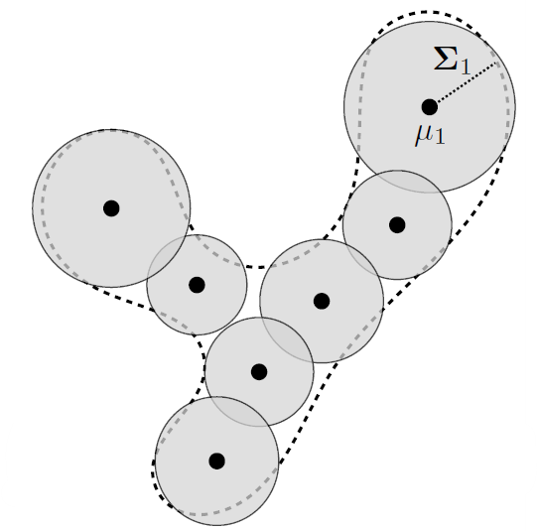
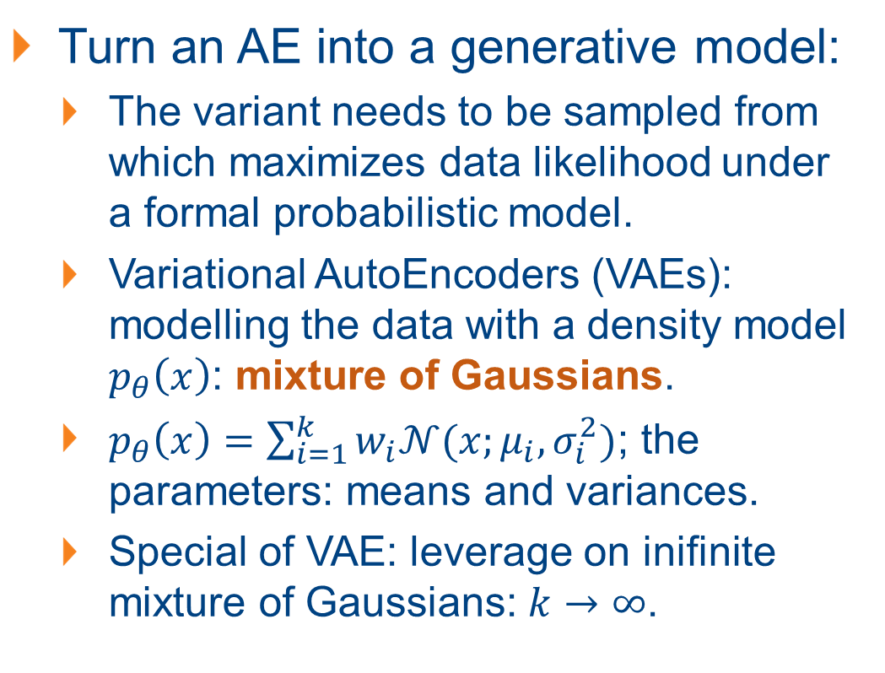
Adapting Autoencoder (AE) for Generative Modelling
Turn an AE into a generative model:
The variant needs to be sampled from which maximizes data likelihood under a formal probabilistic model.
Variational AutoEncoders (VAEs): modelling the data with a density model $p_{θ}\left(x\right)$: mixture of Gaussians.
$p_{θ}\left(x\right)=\sum_{i=1}^{k}{w_{i}𝒩(x;μ_{i}, σ_{i}^{2})}$; the parameters: means and variances.
Special of VAE: leverage on inifinite mixture of Gaussians: $k→∞$.
Model distribution
Target Distribution

Slide 36
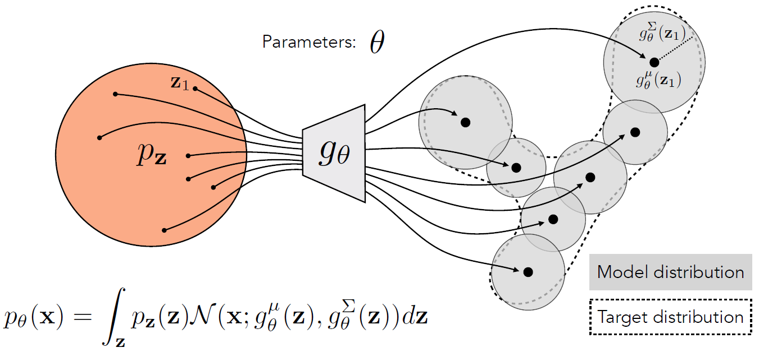
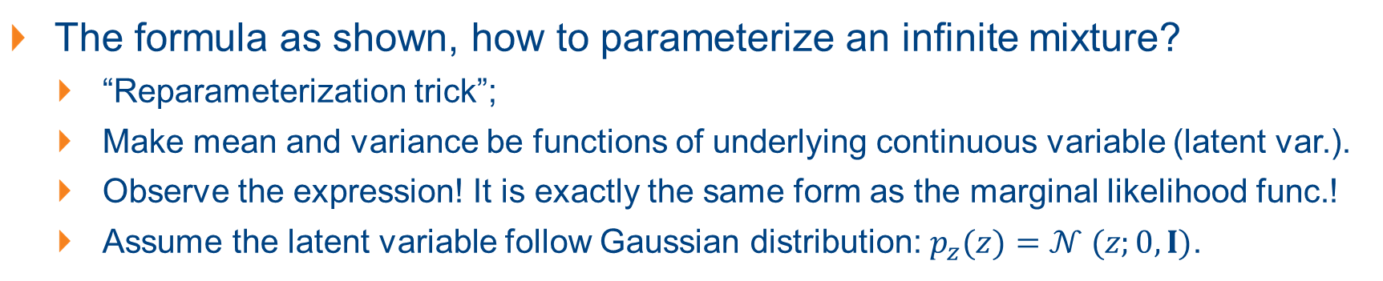
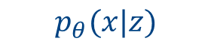
Adapting Autoencoder (AE) for Generative Modelling
The formula as shown, how to parameterize an infinite mixture?
“Reparameterization trick”;
Make mean and variance be functions of underlying continuous variable (latent var.).
Observe the expression! It is exactly the same form as the marginal likelihood func.!
Assume the latent variable follow Gaussian distribution: $p_{z}(z)=𝒩 (z;0, I)$.
$$p_{θ}(x|z)$$

Slide 37
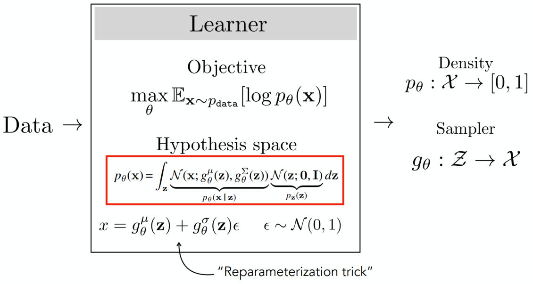
Adapting Autoencoder (AE) for Generative Modelling

Slide 38



Learning the Model Parameters of VAEs
The optimum parameter is obtained with:
$θ^{∗}=\arg{\max_{θ}{L\left({\left\{x^{i}\right\}}_{i=1}^{N}, θ\right)}}=\arg{\max_{θ}{\sum_{i=1}^{N}{\log{p_{θ}(x^{i})}}}}=\arg{\max_{θ}{\sum_{i=1}^{N}{\log{\int_{z}{𝒩\left(x^{i};g_{θ}^{μ}\left(z\right),g_{θ}^{σ^{2}}\left(z\right)\right)𝒩\left(z;0,I\right)dz}}}}}$.
Difficult to obtain directly, apply certain mathematical tricks!
Trick 1: Approximate the objective via Sampling. (An Monte Carlo estimation of the integral)

Slide 39







Learning the Model Parameters of VAEs
Trick 2: Efficient Approximation via Importance Sampling:
Problem with Trick 1: higher dimension $z$, more samples needed. But when approx. the likelihood intensity for $p_{θ}(x)$, only sample $z^{(2)}$ works.
Importance sampling: only sample $z$ values that place high probability on $x$, where values of $p_{θ}(x|z)$ is large.
Define $q_{z}$ whose optimal is $q^{∗}=p_{θ}(Z|x)$: a prediction of which $z$ values most likely to have generated the observed $x$.
Notes:
Rather than sampling z(i) ∼ pz, we sample from some other density z(i) ∼ qz

Slide 40

Learning the Model Parameters of VAEs

Slide 41




Learning the Model Parameters of VAEs
Now we know we should be sampling from $p_{θ}(Z|x)$, how?
VAEs leverage on variational inference (Trick 3): predict the optimal sampling distribution for each given datapoint.
Approx. $p_{θ}(Z|x)$ with $q_{ψ}$ which is a Gaussian function $𝒩(f_{ψ}^{μ}\left(x\right),f_{ψ}^{σ^{2}}\left(x\right))$, where $f_{ψ}$ maps from data $x$ to the latent var. $z$, a probabilistic encoder.
Notes:
The remaining problem: this distribution may be complicated, how?

Slide 42


Learning the Model Parameters of VAEs
To best approx. $p_{θ}(Z|x)$ with $q_{ψ}$, the optimal $q_{ψ}$ is obtained by min. the KL-divergence between $q_{ψ}$ and $p_{θ}(Z|x)$. The objective function $J_{q}$ is:
The optimal parameter $ψ$ for $q_{ψ}$ is obtained as: ($\log{p_{θ}(x)}$ is constant)
Notes:
Here we have defined a new cost function, J, whose minimizer with respect to $ψ$ is the same as the minimizer for Jq.

Slide 43


Learning the Model Parameters of VAEs

Slide 44


Learning the Model Parameters of VAEs
Question: how is learning $q$ related to learning $p$?
$p$ and $q$ now share the same exact objective, learning $q$ is learning $p$!
$θ^{∗}, ψ^{∗}=\arg{\min_{θ,ψ}{J(θ,ψ)}}$

Slide 45


Learning the Model Parameters of VAEs

Slide 46

Training a VAE: Step-by-Step
Sample one or more $x\sim {\left\{x^{(i)}\right\}}_{i=1}^{N}$;
Encode the data with a forward pass through $f_{ψ}$;
For each datapoint, create one or more noisy latent codes using the distribution parameterized by the encoder;
Decode the data by passing the noisy latent codes through $g_{θ}$;
Compute the losses and backprop to update $θ$ and $ψ$.

